Slide 1
春秋青铜蟠龙鼓座铸造工艺的再探讨
Further Discussion on the Casting Technology of the Spring and Autumn Copper Drum Stand with a Coiled Dragon
万 俐 马新民 郑东平
Wan Li , Ma Xin-min , Zheng Dong-ping
學

Slide 2
Contents
壹
貳
叁
肆
伍
前言
蟠龙鼓座
仪器分析
讨论
结语
Introduction
Discussion
conclusion
Drum Stand with a Coiled Dragon
Instrumental analysis

Slide 3
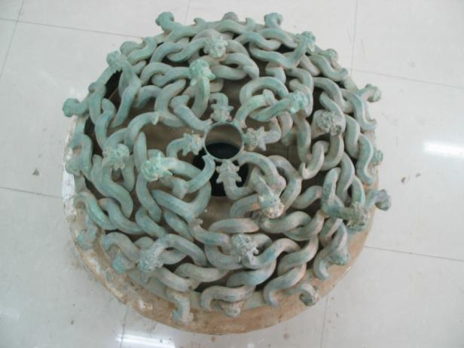
一、前言Introduction
春秋战国出现的镂空蟠龙纹，是研究古代铸造工艺非常难得的实物材料。为此，依据金相、X荧光分析仪和表面观察所得到的信息，再次探讨了河南省平顶山市叶县四号春秋墓出土的青铜蟠龙鼓座的制作工艺，以此抛砖迎玉。
Spring and Autumn and Warring States appeared hollow coiled dragon pattern, It is a rare physical material for studying ancient casting techniques.Based on the information obtained from metallography, X-ray fluorescence analyzer, and surface observation, the production process of the bronze dragon drum seat unearthed from the 4th Spring and Autumn Tomb in Ye County, Pingdingshan City, Henan Province was further explored.

Slide 4
二、蟠龙鼓座Drum Stand with a Coiled Dragon
鼓座通高：16厘米直径：74.5厘米
Drum base height: 16 cm,
Diameter: 74.5 cm.
由分圈足（外圆）、管状圆环（内圆）和32条蟠龙组成。
Composed of a split-ring foot (outer circle), a tubular ring (inner circle) and 32 coiled dragons.

Slide 5
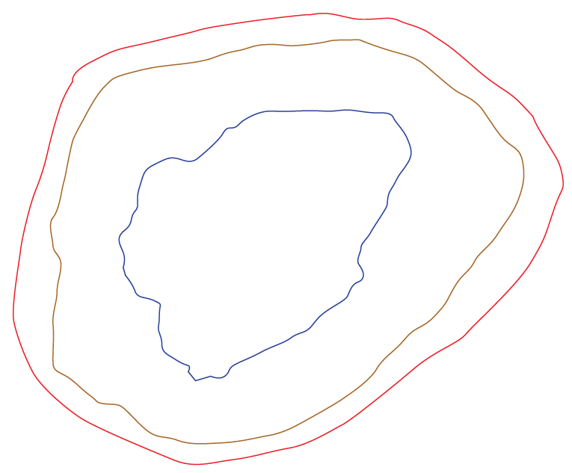
三、仪器分析Instrumental analysis
蟠龙横断面大致呈五棱体，
长、短直径约介于 2.3-3.5 厘米；断面分三层即：
1、外层是0.1厘米厚的铜体；
2、中间为桔色范土，厚约 1.1-1.4 厘米；
3、内层是很疏散的金属，厚约 2.1-2.4 厘米。
The cross-section of Coiled Dragon is roughly pentagonal.
The long and short diameters range from 2.3 to 3.5 cm;
The cross-section is divided into three layers:
① outer layer: copper body, ca. 0.1 cm
② Middle layer: orange vanilla, ca. 1.1-1.4 cm;
③ inner layer: very sparse metal, ca. 2.1-2.4 cm.
①
②
③

Slide 6
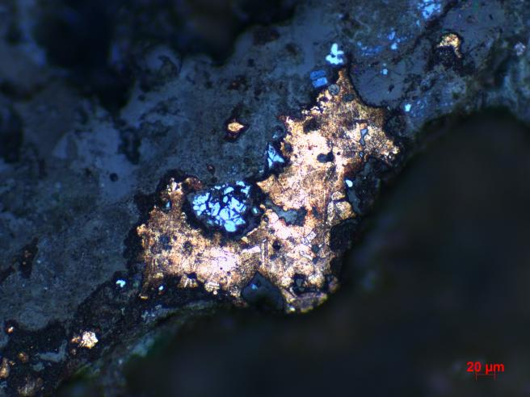
X射线荧光能谱仪与金相分析
1、X射线荧光能谱仪X-ray fluorescence spectrometer
2、金相Metallographic analysis
No/element | Cu | Sn | Pb | Si | Fe
外层Outer layer | 69.125 | 19.606 | 7.600 | 1.557 | 0.3825
内层Inner layer | 20.011 | 4.548 | 17.507 | 37.586 | 9.479
龙的内层合金：铸后有局部热锻。
Dragon's inner layer alloy: After casting, there is partial hot forging.
泥芯中金属的金相图
Metallographic diagram

Slide 7
四、讨论Discussion
鼓座中的32条蟠龙，共有7种造型:
There are 7 different shapes from the 32 coiled dragons in the drum seat.
1号龙：头接内圆、尾部接外圆
Dragon 1: Head connected to inner circle, tail connected to outer circle
2号龙：头接外圆、尾部接内圆
Dragon 2: Head connected to outer circle, tail connected to inner circle
3号龙：嘴向内仰头
Dragon 3: Mouth facing inward head
4号龙：翘尾巴
Dragon 4: Tail raised
5号龙：龙头上带角
Dragon 5: Horn on dragon head
6号龙：尾巴卷起
Dragon 6: Tail rolled up
7号龙：龙嘴向外仰头回首的形态
Dragon 7: Mouth facing outward and looking back.

Slide 8
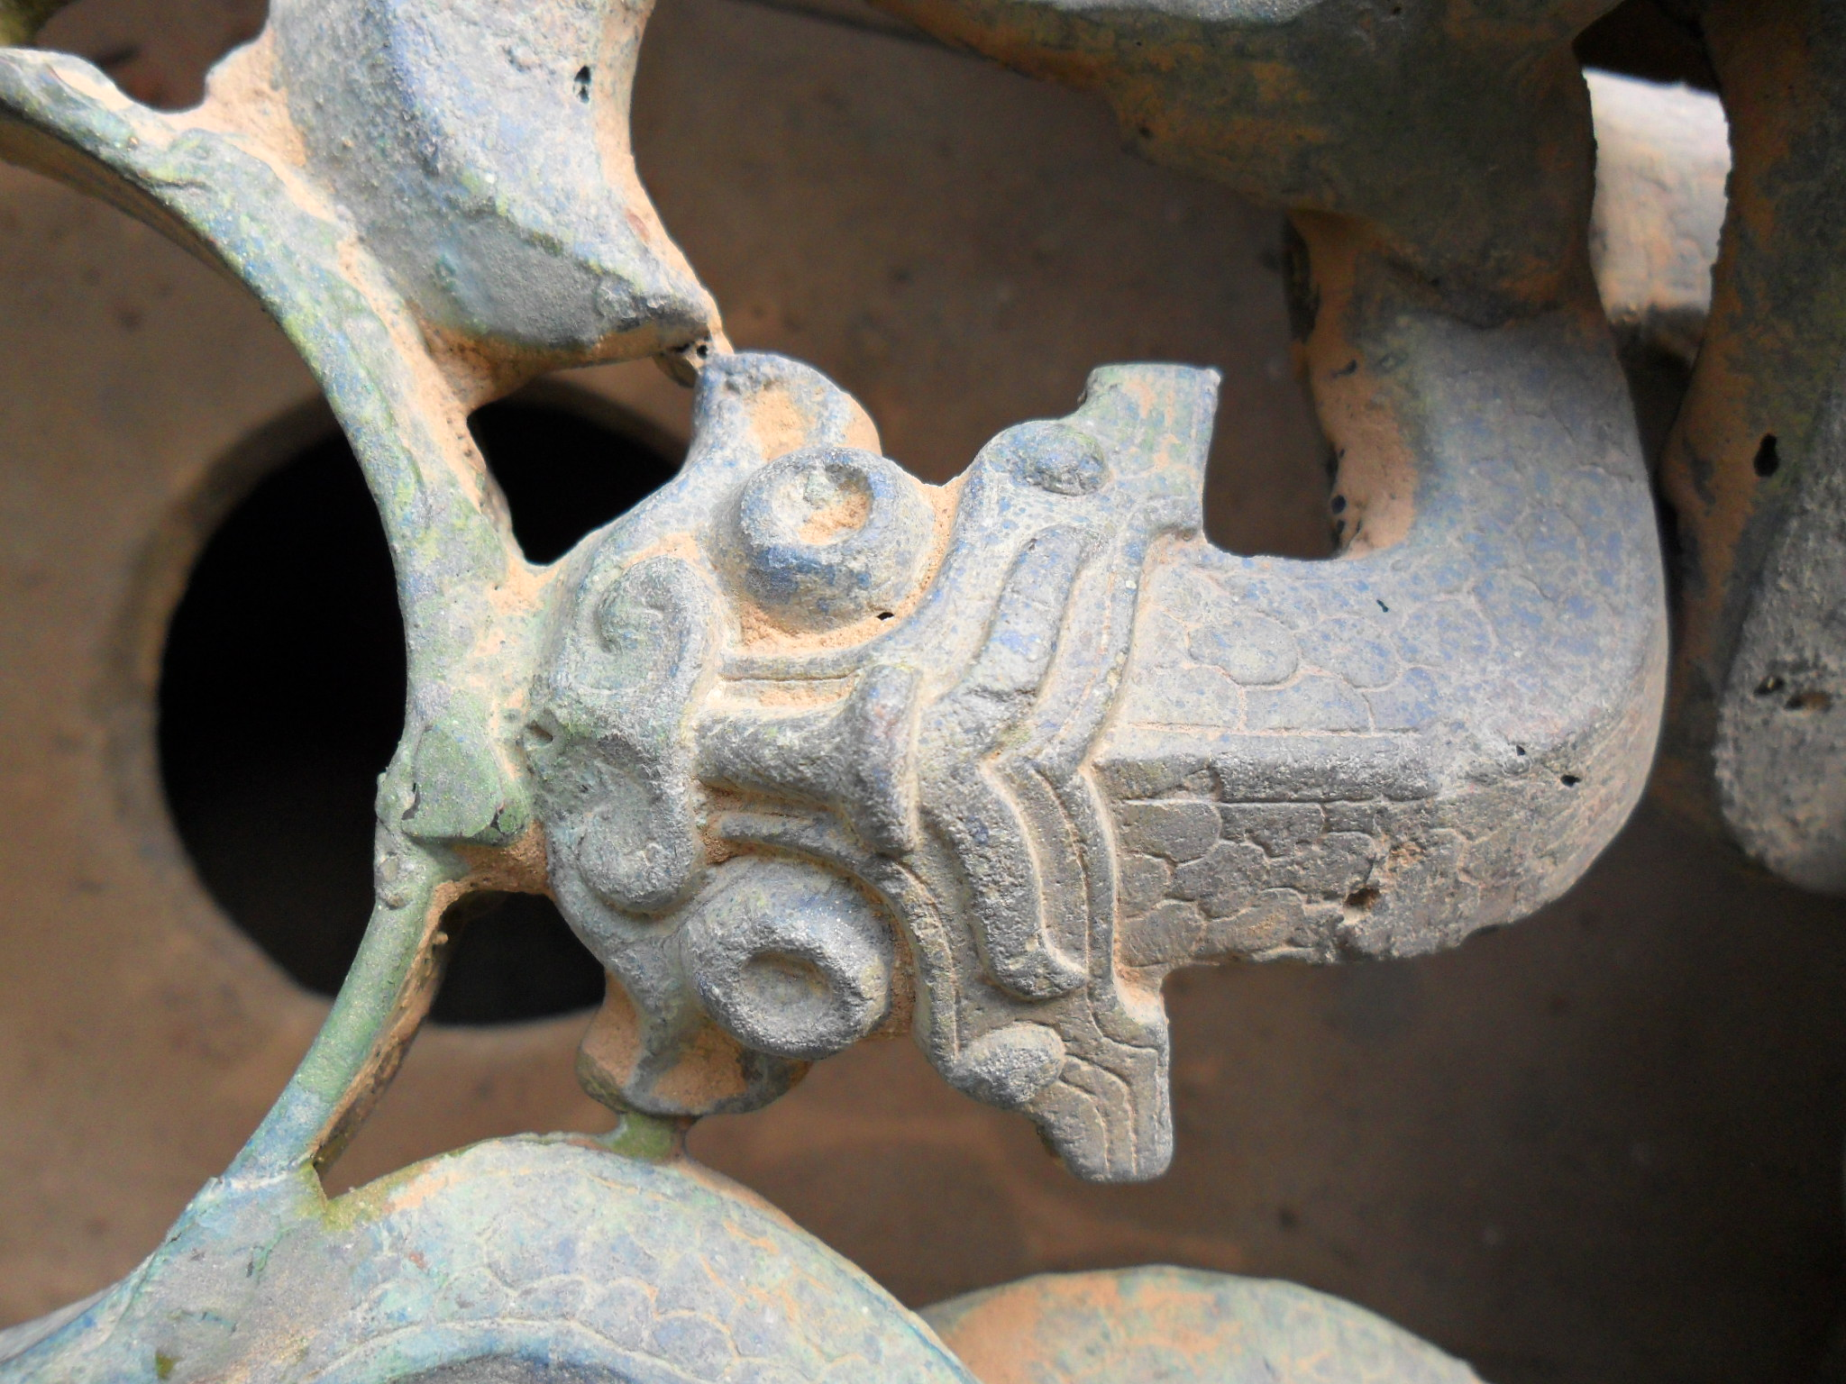
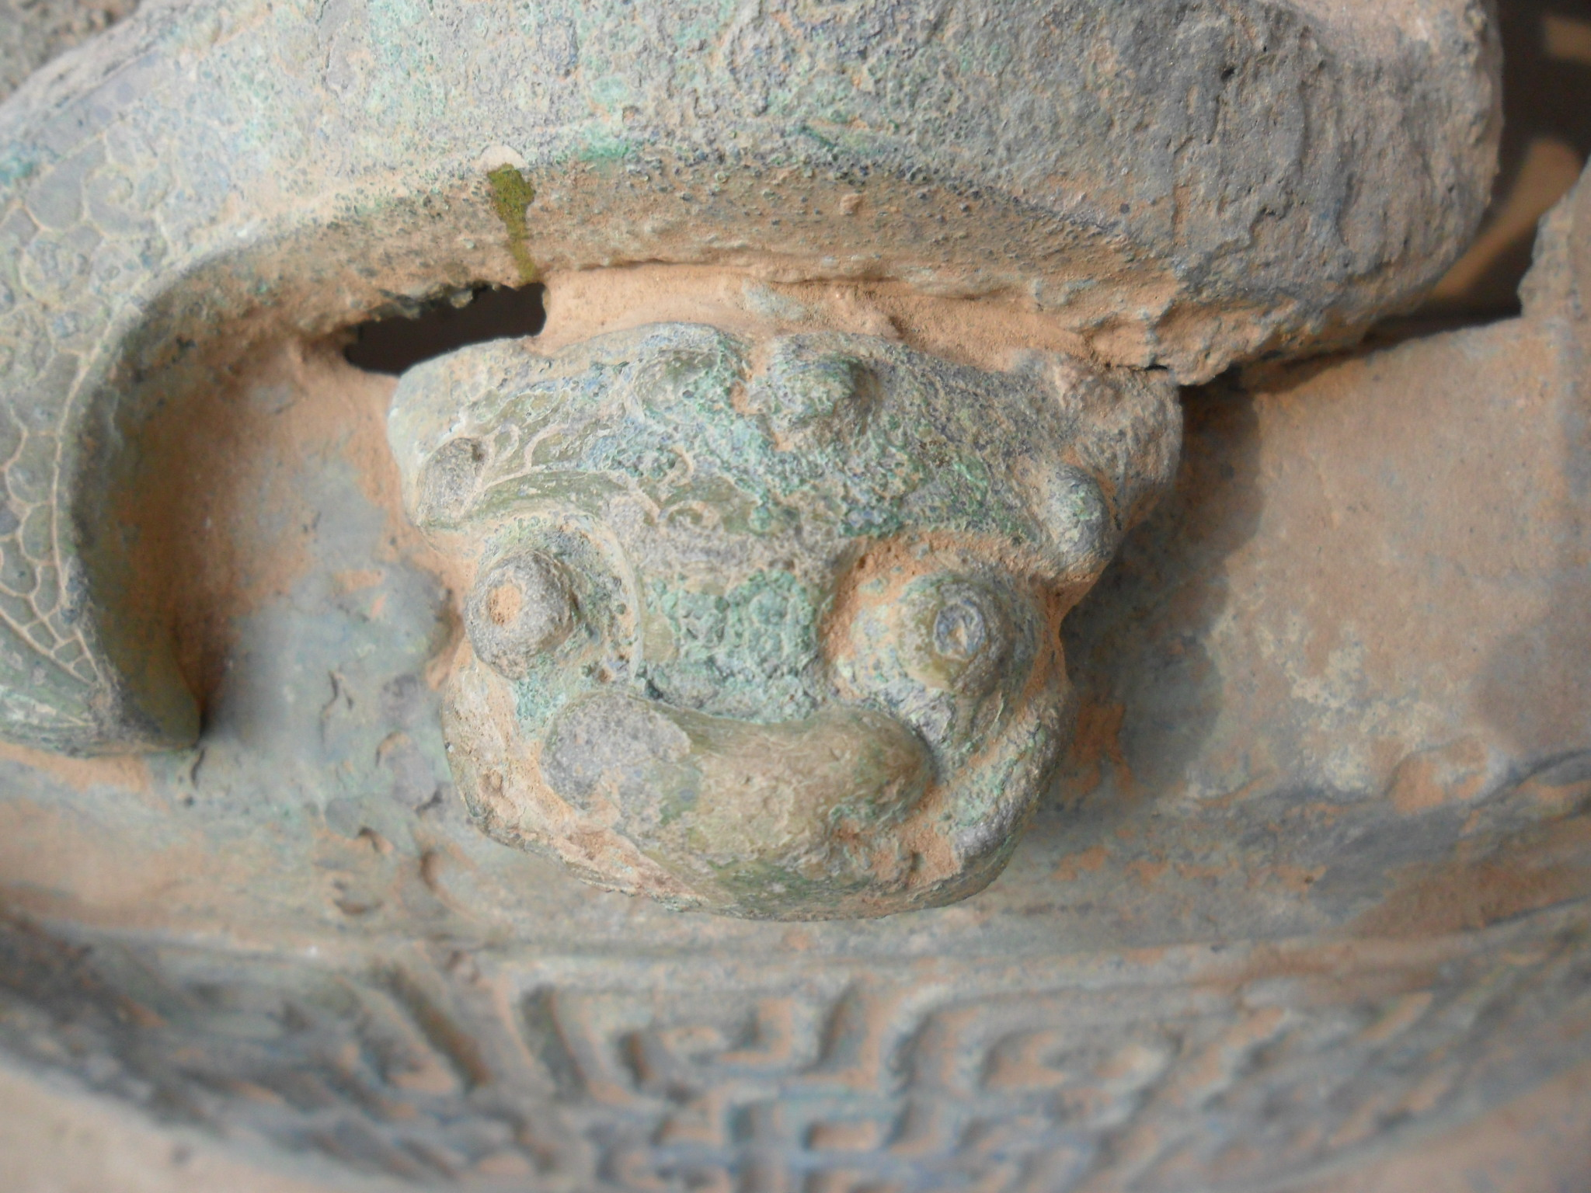
4.1蟠龙的造型
The design of the coiled dragon
1号龙
2号龙
Dragon 1
Dragon 2

Slide 9
4.2蟠龙的作用
The function of the coiled dragon
7种蟠龙中，1和2号蟠龙的龙身最长，是连接外圆和内圆，而其余5种蟠龙，做成不同的造型，穿插、缠绕在1号和2号龙的周围，达到镂空的目的。
Among the 7 kinds of dragons, the bodies of dragons 1 and 2 are the longest, connecting a circle from outer to inner, while the other 5 kinds of dragons are made into different shapes, interspersed and wrapped around dragons 1 and 2 to achieve the purpose of hollowing out.

Slide 10
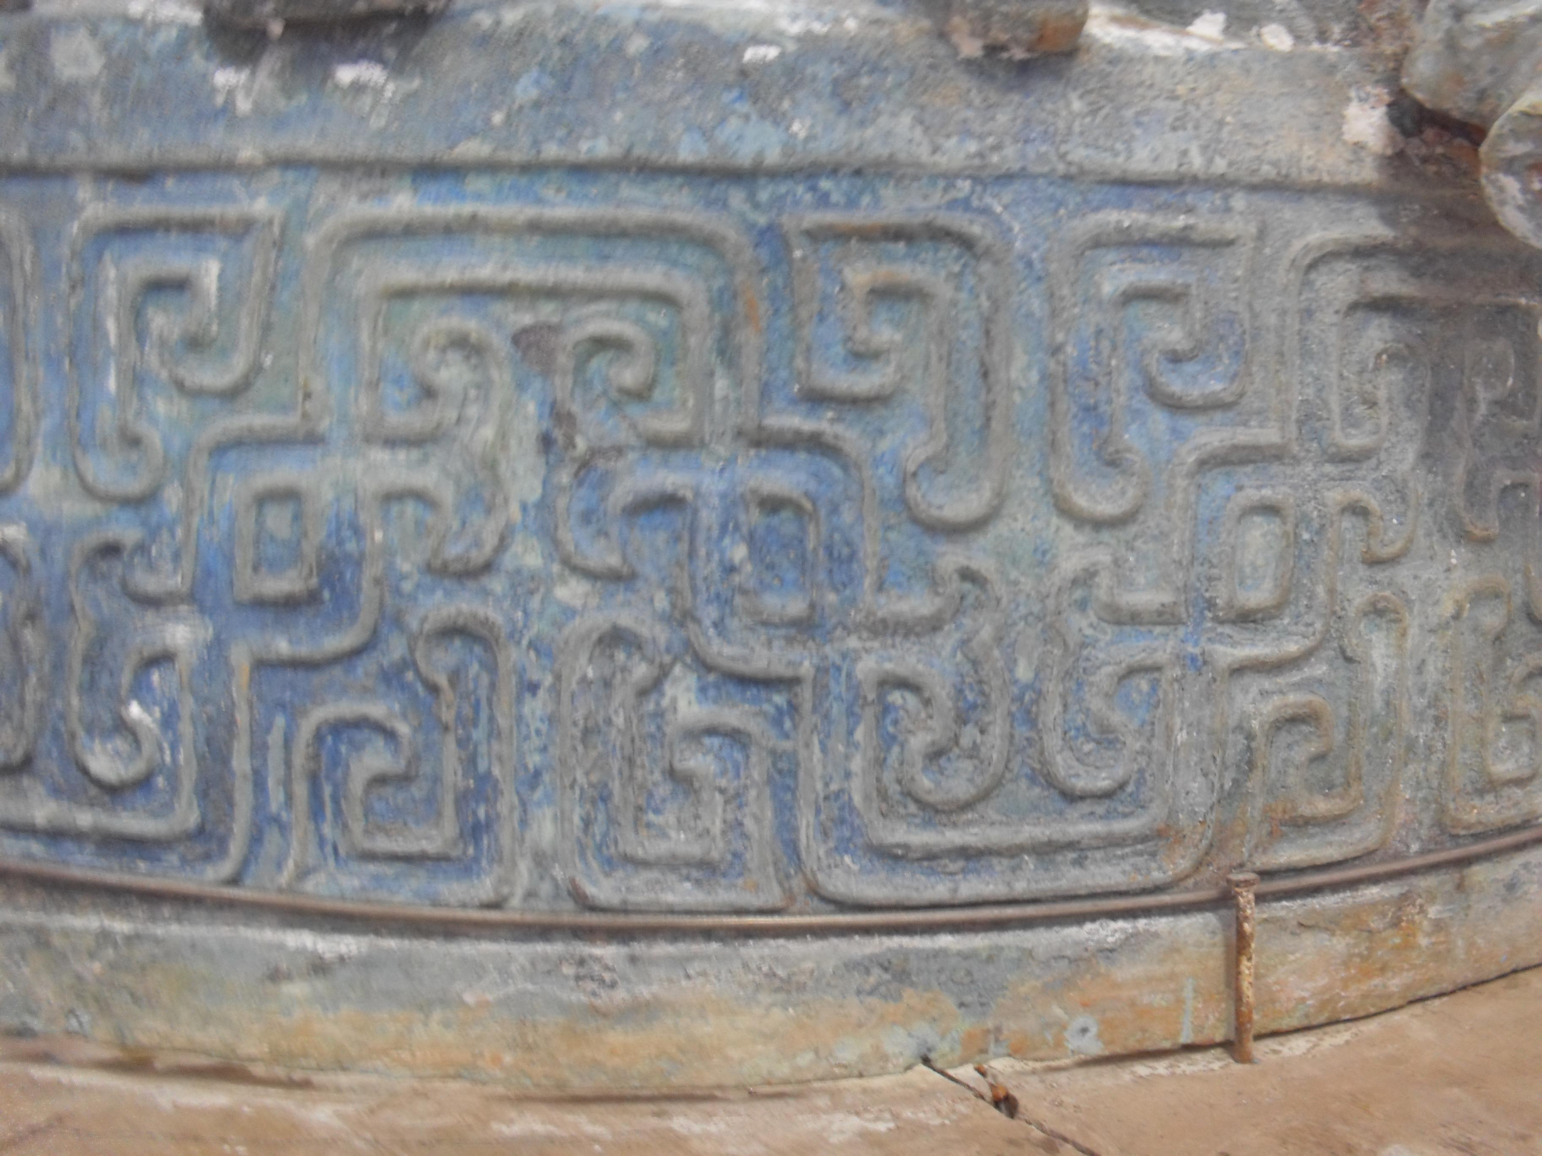
4.3鼓座纹饰
The drum seat ornamentation
从32条蟠龙背部都饰以细密鳞纹的阴纹，而外圆上的变形蟠虺纹是阳文这一现象，可以推测：蟠龙的阴文是在塑形蟠龙模时刻划，外圆上的蟠虺阳纹是在陶范上形成。
It is the phenomenon that the back of the 32 coil dragons is decorated with Yin lines, and the Coiling Snake Pattern on the outer circle with Yang lines, we can speculate that the Yin lines of the coil dragon is drawn at the time of shaping mold, and the Coiling Snake Pattern on the outer circle is formed from the pottery pattern.

Slide 11
4.4蟠龙的制作工艺
The process of making the coiled dragon
1、龙的内芯或称盲芯：用含铜量很低的金属为材料，并根据蟠龙的造型热锻；
2、敷上塑形泥，塑蟠龙形；
3、制作二块陶范；
4、使用刮削工艺确定蟠龙铸造的厚度；
5、合范、焙烤；
6、浇铸。
①Dragon’s inner core ( blind core ):
To use a metal with low copper content as the material, and forge it through heat forging according to the shape of the coiled dragon.
②To apply sculpting clay in order to shape the form of the coiled dragon.
③Making two pottery models
④Using the scraping process to determine the thickness of the coiled dragon during casting.
⑤composite mold; Baking
⑥cast

Slide 12
4.5蟠龙的装配
The assembly of the coiled dragon
1、从1号蟠龙头部连接内圆、2号的尾部连接外圆的现象推测：1和2号8条龙与外圆和内圆的部分可能是一次浇铸成形。
2、3和7号的24条蟠龙，从鼓座实物上观察，蟠龙相互缠绕弯曲的动态和连接点，可能是分别浇铸后焊接而成。
From the phenomenon that the head of No.1 is connected to the inner circle, and the tail of No.2 is connected to the outer circle, it is speculated that the parts of the 8 dragons with the outer circle and the inner circle of No.1 and No.2 May be cast in at the same time.
From the physical observation of the drum seat, it can be seen that the dynamic and connecting points of the 24 coil dragons on No.3 and No.7 are intertwined and bent, which may have been cast and welded separately.

Slide 13
4.6蟠龙的意义
The significance of the coiled dragon
研究相互缠绕并呈现弯曲动态的蟠龙制作工艺，对于探索战国时期镂空蟠龙铜器的制作工艺具有重要意义。如：战国透空蛟龙纹镜。
Studying the production techniques of interwoven and dynamically curved dragons is of great significance for exploring the production techniques of hollowed-out dragon-shaped bronze artifacts from the Warring States period.
such as：The Warring States hollowed-out dragon-patterned mirror.

Slide 14
五、结语Conclusion
综上所述，依据仪器分析 ，再次探讨了青铜蟠龙鼓座的制作工艺，虽然阐述了一些初步的观点，但有些问题还需进一步的研究，如：
In conclusion, based on instrumental analysis, the production techniques of the bronze dragon-shaped drum stand were further explored. Although some preliminary viewpoints have been elucidated, certain issues still require further research.For example:
1、弯曲起伏的1号、2号蟠龙与外圆和内圆是否一次浇铸成形，其陶范的分型工艺？
①Whether the first and second coiled dragons were cast in one piece with the outer and inner circles, and what was the ceramic mold casting process?
2、7种不同造型蟠龙的取名是用形状还是根据连接或镂空的功能定名？
②Are the names of the 7 different shaped coiled dragons based on their form or are they named according to their connected or hollowed-out functions?
3、3号与7号每条蟠龙的陶范分型是几块？
③How many pieces are used in the ceramic mold casting process for the 3rd and 7th coiled dragons?

Slide 15
结语Conclusion
4、3号和7号之间的24条蟠龙是否与1号蟠龙连接时用焊接？
④Are the 24 coiled dragons between the 3rd and 7th connected to the 1st coiled dragon using welding?
5、蟠龙最内层金属的制作工艺？
⑤What is the manufacturing process of the innermost layer of metal for the coiled dragon?
6、龙的铜体含有硅，而内层的金属又有高含量的硅，此硅来自哪里？为什么？
⑥The copper body of the dragon contains silicon, and the inner layer of metal also has a high silicon content. Where does this silicon come from ？why?
以上关于春秋蟠龙鼓座的制作工艺问题，还有待今后进一步的探讨，期待与亚洲铸造史的会员们共同研究！
The inquiries into the manufacturing process of the Spring and Autumn Coiled Dragon Drum Seat warrant further examination in the future. We eagerly anticipate partnering with members of the Asian Casting History Association for a collaborative study on this subject!

Slide 16
鸣谢：南京博物院文保所田建花副所长，为本文金相分析等所做的工作，在此表示衷心的感谢！ Acknowledgements: Sincere gratitude to Deputy Director Tian Jianhua of the Conservation Department at Nanjing Museum for their contribution to this article, particularly in the field of metallographic analysis.

Slide 17
谢谢！
Thank you!
万俐
學

