Slide 1
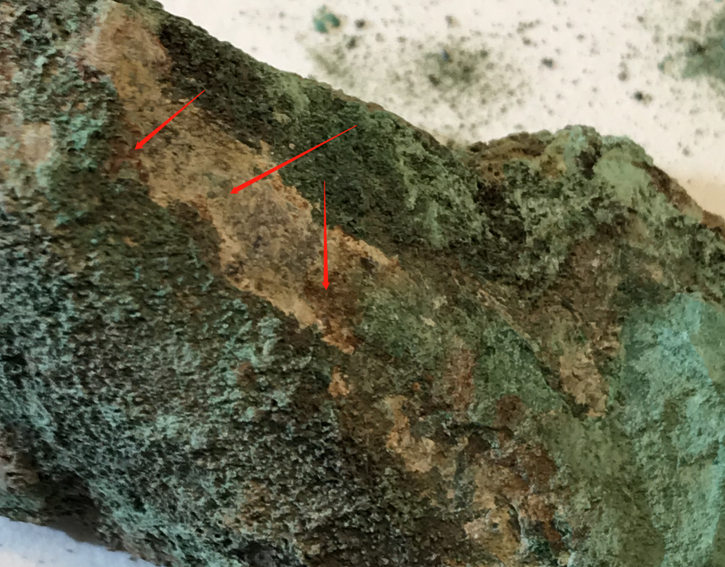
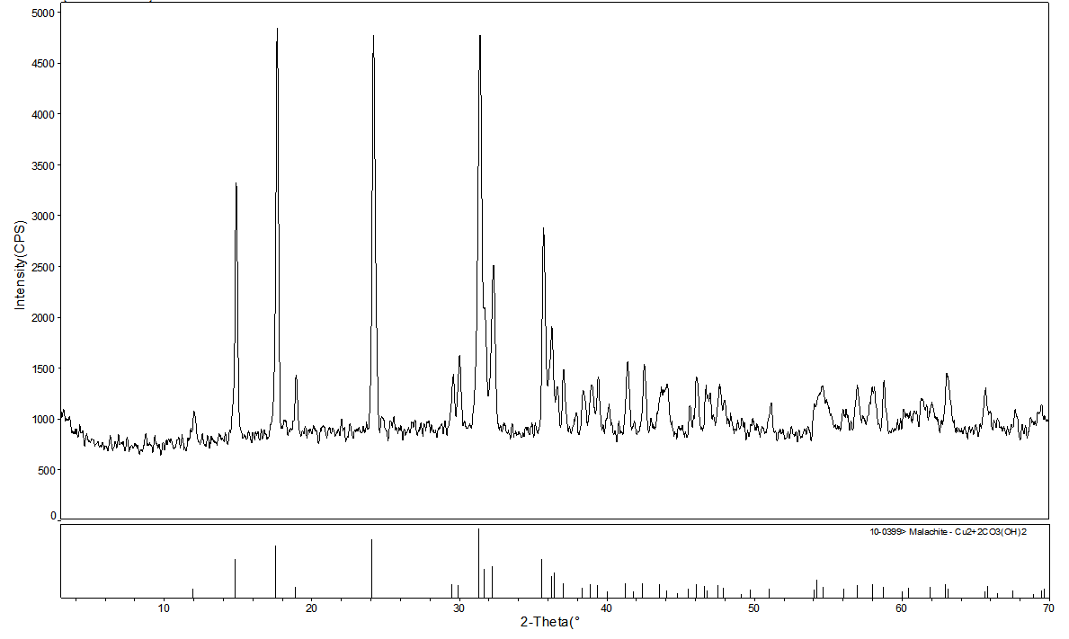
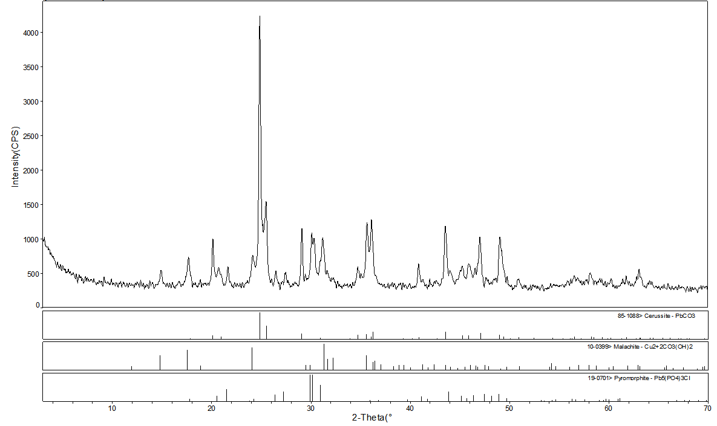
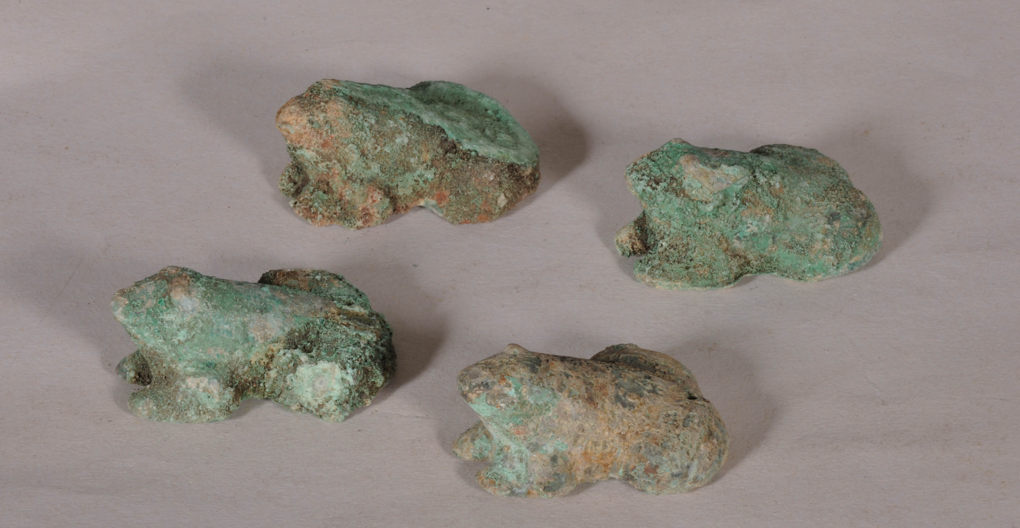
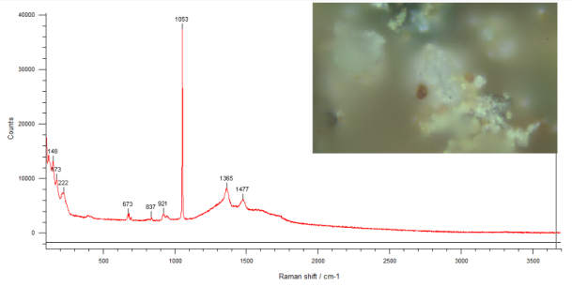
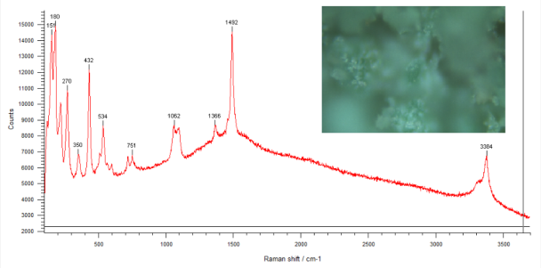
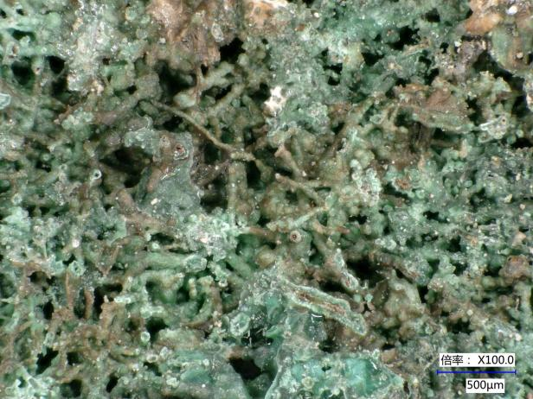
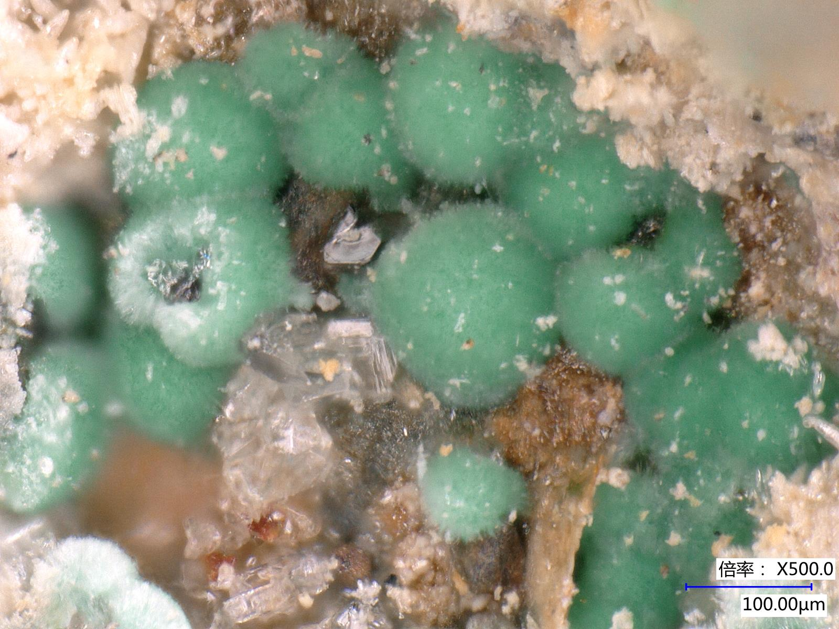
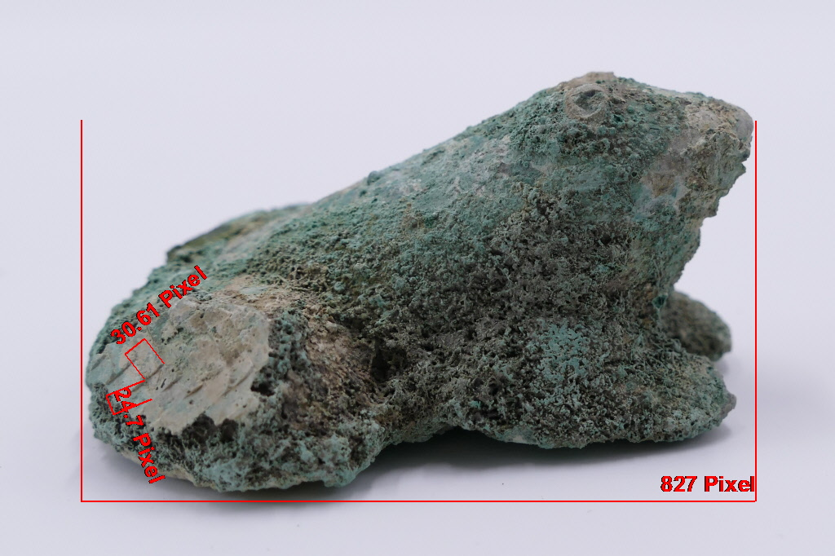
Preliminary analysis of the bronze frog shape Xizhen in Han Dynasty
LI Qianqianª , Han Chaoª , Wan Li^{b }
a Changzhou Museum,Changzhou,Jiangsu 213000
b Nanjing Museum, Nanjing,Jiangsu 210000
Corresponding author: wanlinb@126．com
1. Introduction
2.3.X-ray detector Analysis
there is no clear boundary between the inside and the outside of the zhen, almost as one --- difficult to discern the casting information.
This article focuses on a group of 4 bronze frog-shaped Xizhen unearthed from Yunjiadun Tomb of Han Dynasty. The surface and exposed internal fillers were detected using portable fluorescence spectroscopy analyzer (PXRF), optical microscope, X-ray inspection, and other methods. The results indicate fact that the external shell of the Xizhen is made of lead-tin bronze while the internal filler is made of lead. These four artifacts can be recognized as the first published archaeological materials of frog-shaped Xizhen made of composite metal in Jiangsu Province. Therefore, based on weight ratio analysis of copper and lead, the addition of lead into the internal space can improve the stability and practical function of the artifact. The scientific examination is of great significance to the conservation and restoration of the Xizhen as well as the study of the use and appreciation of ancient bronzes.( Fig. 1.)
Fig.5 X-ray inspection images
Fig.4 inner
2.4.XRD diffraction analysis
Fig.6 Surface green --Cu₂(OH)₂CO₃ Fig.7 Near white -- Cu₂(OH)₂CO₃、PbCO₃、Pb₅(PO₄)₃Cl
2.5.Raman spectrum
Fig.8 Fine needle picking of white powder inside--PbCO₃ Fig.9 Surface Green- Cu₂(OH)₂CO₃
3.preliminary summary
According to PXRF, X-ray detector, XRD and raman spectra analysis,Xizhen is solid lead on the inside and lead-tin-bronze on the surface.Therefore, the seat of the zhen for the lead-tin bronze frog-shaped shell, the inner belly of the lead-filled composite artifacts. 2, 3, and 4 have remnants of bronze exterior troglodyte shells, while Xizhen 1 is almost lead.
4.Discussion
4.1.Relationship between lead content and Xizhen weight
Material is the main factor affecting its weight.ancient Xizhen are generally weighing about 300-1500g.However, that the weight of this was less than 300g（m1≈189.7g、m2≈218.9g、m3≈184.4g、m4≈218.6g）.
The drainage method measures the frog shaped volume :v1=44ml、v2=49ml、v3=46ml、v4=52ml.Assuming full lead, m =ρv→m1≈497.2g、m2≈553.7g、m3≈519.8g、m4≈587.6g，It can achieve better pressing standards.
Based on the mass difference △m≤90.4 between m1 and m2, m3, and m4, inferred that the bronze frog shell is a thin-walled bronze component.
4.2.Functions and connotations of copper system frog shells
Lead Zhen surface copper cladding, can enhance corrosion resistance, but also save copper, and have a“gold-like”artistic beauty and status enhancement.Lead has a higher density than copper, making it more beneficial for pressing mats.combined use the two materials reflect the ancient people's knowledge of the alloy composition and the technology, By combining with the frog shaped , it achieves a perfect unity of artistic beauty and practical functions.
4.3.How to Combine Lead and Bronze
4 pieces of the same size and shape are mostly cast in the same mold.
It is possible : ①The lead frog is cast firstly, the copper skin is attached to its surface for its beauty, and forge it according to its shape. ②Bronze forged frog shell firstly, then filled with lead. Forged the copper skin into a frog shaped shell，cast lead liquid at the bottom.
Due to seriously corrosion in Xizhen, many technological processes cannot be clearly understood and need further exploration.
Fig. 1. Han Dynasty Bronze Frog-shaped Xizhen.
2. Experimental and Results
2.1. Three-dimension video microscope
Fig.2 Microscopic image of corroded sample Fig.3 Mat imprint
The corrosion is severely layered , the bottom layer is emitting green rust, which has seriously damaged the cultural relic substrate.
On the right rear leg of Xizhen, there are still warp and weft woven patterns on the mat
Diameter length: 1.79mm；weft length: 2.22mm.
The zhen should have been covered with a mat underneath, revealing the relationship of the zhen to other burial objects in the artifactual assemblage of the tomb.It also reflects its utility when it was a living utility and its role in burials.
2.2.P-XRF non-destructive analysis
PXRF collects signals from various locations in Xizhen: Table 1
The outer surface of No. 2, 3 and 4：lead-tin bronze
Bare off-white positions ：Cu(43～54%）、Pb（45～52%）、Sn（0.5～3%）No. 1 seat zhen,Pb（81～86%）、Cu(13～15%）、Sn<0.5%.
What is the explanation for the large amount of lead at the bottom off-white location?
No./ element | Cu | Pb | Sn
No.2、3、4top green | 51-78 | 11-27 | 6-24
No.2、3、4Bare off-white | 43-54 | 45-52 | 0.5-3
No.1 | 13-15 | 81-86 | 0-0.4

